Slide 1
Midterm Project Demo
Ayushi Sinha, Shuya Chu, Yuge Gong

Slide 2
Crossbow
Assembly
Align using Bowtie
Merge
Analyze
Run on Hadoop MapReduce

Slide 3
Our Method
Pseudo-Assembly
Align using fast string matching using FFTs
Merge
Analyze
Run on Spark+Distributed GraphLab
Notes:
Pseudo-assembly – Because we are focusing our application to aligning reads to a reference, whereas assembly is really a component involved in multiple read alignment. However, once we have matches, we do need some sort of an assembly-like process to merge the matches into contigs, etc.
Run the FFT part of the algorithm on Spark (?), then build a graph to ingest onto GraphLab to efficiently merge.

Slide 4


Align
Bowtie uses Burrows-Wheeler
Find exact match
If not found, find inexact match
Inexact match should have lowest quality value sum
Backtrack up to a backtracking ceiling
Time complexity: >O($NM$)
≈O($N^{k}$)
We propose to use FFTs
Find exact match, i.e., match that gives the highest response possible
If not found, pick best inexact match, i.e., next highest response
If multiple inexact matches found, choose one with lowest quality value sum
Discard best matches whose response is below some threshold
Time complexity: O($N\log{N}$)
Notes:
Burrows-Wheeler for exact and inexact matches VS FFTs for fast string matching
Each character in a read has a numeric quality value, with lower values indicating a higher likelihood of a sequencing error. In an inexact match, the aim is to minimize this quality value sum.
N = length of read, M = length of reference, k = maximum allowed edit distance
Bowtie: Worst case time complexity is O(NM) because each exact match using Burrow-Wheeler is O(N), and for each match, if an exact match is not found, a greedy depth first search is conducted on the length of the suffix trie for the reference to find the best inexact match, which is O(M) in the worst case. But, in this application, you only need to check the overlap between the suffix trie O(M²) and the neighborhood trie for the read O(N^{k}), which contains string within the edit distance.
Also, we don’t need to compute the Burrows-Wheeler transformation matrix, etc.
FFTs: Time complexity of O(NlogN) makes this great for short reads
Space O(N)

Slide 5
Fast String Matching using FFTs
Brute Force String Matching
g a t c g a t c a g c a a t c a g c a c a g c
a t c a g c a c a g
Target
Pattern

Slide 6
Fast String Matching using FFTs
Brute Force String Matching
g a t c g a t c a g c a a t c a g c a c a g c
a t c a g c a c a g
Notes:
We check if the characters in the pattern match the corresponding characters in the target.

Slide 7
Fast String Matching using FFTs
Brute Force String Matching
g a t c g a t c a g c a a t c a g c a c a g c
a t c a g c a c a g
Notes:
And we do this for each position in the target

Slide 8
Fast String Matching using FFTs
Brute Force String Matching
g a t c g a t c a g c a a t c a g c a c a g c
a t c a g c a c a g

Slide 9
Fast String Matching using FFTs
Brute Force String Matching
g a t c g a t c a g c a a t c a g c a c a g c
a t c a g c a c a g

Slide 10
Fast String Matching using FFTs
Brute Force String Matching
g a t c g a t c a g c a a t c a g c a c a g c
a t c a g c a c a g . . .

Slide 11
Fast String Matching using FFTs
Brute Force String Matching
g a t c g a t c a g c a a t c a g c a c a g c
a t c a g c a c a g

Slide 12
Fast String Matching using FFTs
Brute Force String Matching
g a t c g a t c a g c a a t c a g c a c a g c
a t c a g c a c a g
O(N*M)

Slide 13
Fast String Matching using FFTs
Fast String Matching
g a t c g a t c a g c a a t c a g c a c a g c
a t c a g c a c a g
Knuth et al. ‘77
Notes:
Find first mismatch, and start comparing at the position after that

Slide 14
Fast String Matching using FFTs
Fast String Matching
g a t c g a t c a g c a a t c a g c a c a g c
a t c a g c a c a g
Knuth et al. ‘77

Slide 15
Fast String Matching using FFTs
Fast String Matching
g a t c g a t c a g c a a t c a g c a c a g c
a t c a g c a c a g
Knuth et al. ‘77

Slide 16
Fast String Matching using FFTs
Fast String Matching
g a t c g a t c a g c a a t c a g c a c a g c
a t c a g c a c a g
Knuth et al. ‘77

Slide 17
Fast String Matching using FFTs
Fast String Matching
g a t c g a t c a g c a a t c a g c a c a g c
a t c a g c a c a g
Knuth et al. ‘77
Notes:
Size of the shift on a mismatch is determined by the repetitions in N, independent of M, and can be computed in O(N) time.
The per character comparison takes O(M) time in the worst case.

Slide 18
Fast String Matching using FFTs
Fast String Matching
g a t c g a t c a g c a a t c a g c a c a g c
a t c a g c a c a g
O(N+M) ≈ O(M)
Knuth et al. ‘77
Notes:
O(M) in this case, because the length of the reference >> the length of the reads

Slide 19
Fast String Matching using FFTs
Fast String Matching using FFTs
g a t c g a t c a g c a a t c a g c a c a g c
a t c a g c a c a g

Slide 20
Fast String Matching using FFTs
Fast String Matching using FFTs
g a t c g a t c a g c a a t c a g c a c a g c
a t c a g c a c a g
Restricted Pattern Matching

Slide 21
Fast String Matching using FFTs
Fast String Matching using FFTs
g a t c g a t c a g c a a t c a g c a c a g c
a t c a g c a c a g
Restricted Pattern Matching → Correlation

Slide 22
Fast String Matching using FFTs
Fast String Matching using FFTs
g a t c g a t c a g c a a t c a g c a c a g c
a t c a g c a c a g
Restricted Pattern Matching → Correlation → Multiplication in Fourier Space

Slide 23
Fast String Matching using FFTs
Fast String Matching using FFTs
g a t c g a t c a g c a a t c a g c a c a g c
a t c a g c a c a g

Slide 24
Fast String Matching using FFTs
Fast String Matching using FFTs
g a t c g a t c a g c a a t c a g c a c a g c
a t c a g c a c a g . . .

Slide 25
Fast String Matching using FFTs
Fast String Matching using FFTs
g a t c g a t c a g c a a t c a g c a c a g c
a t c a g c a c a g

Slide 26

Fast String Matching using FFTs
Fast String Matching using FFTs
g a t c g a t c a g c a a t c a g c a c a g c
a t c a g c a c a g
O($N+N\log{N}$) ≈ O($N\log{N}$)

Slide 27
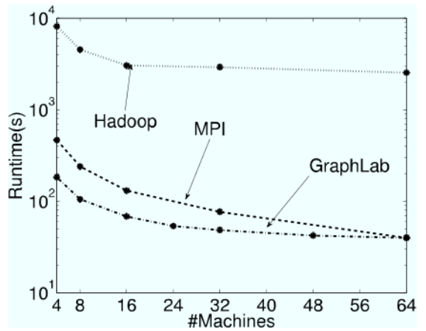
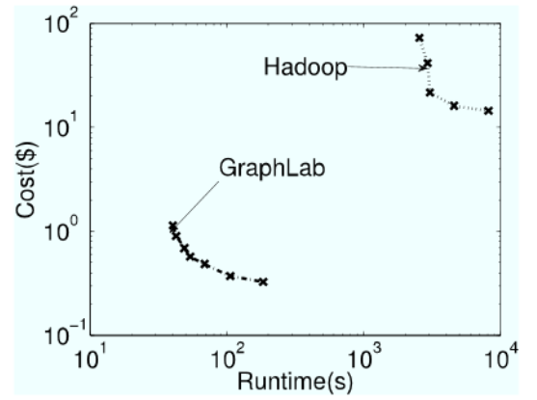
GraphLab vs. Hadoop MapReduce
Notes:
Motivate why we are trying to implement this is GraphLab, rather than Hadoop MapReduce -- GraphLab claims to be faster than Hadoop MapReduce
Runtime of the Netflix movie recommendation algorithm, which uses Alternating Least Squares. GL outperforms MR by 40-60x.
Price performance ratio for the Netflix application on Amazon EC2 – GL is about two orders of magnitude more cost effective than Hadoop.

Slide 28
Merge
Merge aligned reads with largest overlap
How can we do this efficiently?
How can we use GraphLab?
What do we want?
Build some version of the de Brujin Graph
Check only relevant reads for overlap
Notes:
How can we use GraphLab to our benefit?
Check only relevant reads, rather than all reads, for overlap
Check only the relevant neighborhood
Merge nodes with largest overlap → Contigs
Order contigs → Scaffolds

Slide 29
Analysis
Similar to Crossbow
Re-sequence simulated data
Whole-human re-sequencing
Assembly Size
Maximum length of contigs/scaffolds
Average length of contigs/scaffolds
Combined total length of contigs/scaffolds
N50
Notes:
Contig N50 is the length of the smallest contig in the set that contains the fewest (largest) contigs whose combined length represents at least 50% of the assembly

Slide 30
Why is this better?
Improved speed
Fast string matching using FFTS
Distributed GraphLab
Improved spatial complexity?
Notes:
FFTs faster than Burrows-Wheeler inexact match.
The human genome requires only about 3 Gb of space. Hence, it can be stored on each node in a cluster, and alignment with the reference can be independently performed on each node, hence increasing parallel performance.
Distributed GraphLab is faster than MR

Slide 31
Questions/Comments?

